Slide 1
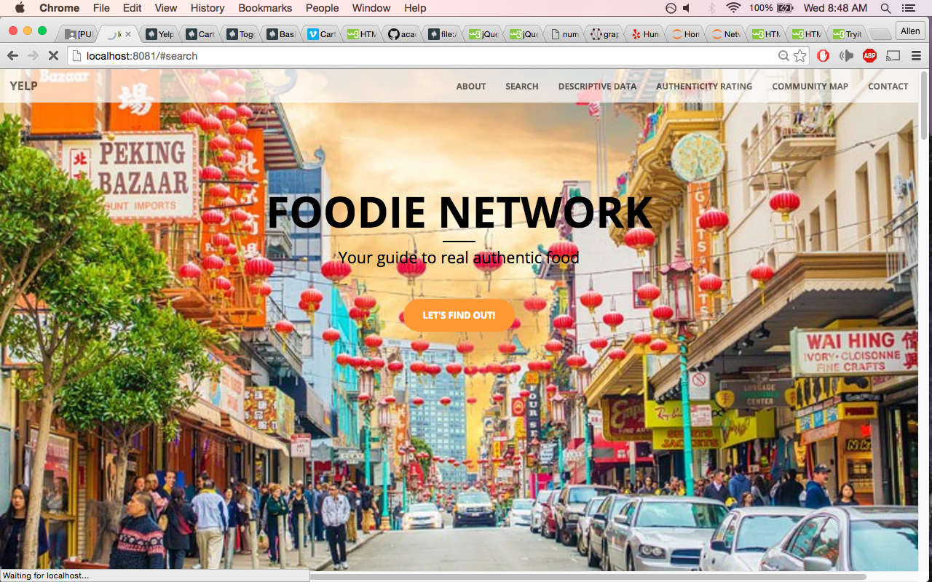

Foodie Network
Your guide to authentic Yelp reviews
Notes:
Good morning Everyone, My Name is Allen and my App is titled Foodie Network it guide users to more authentic Yelp Reviews.

Slide 2
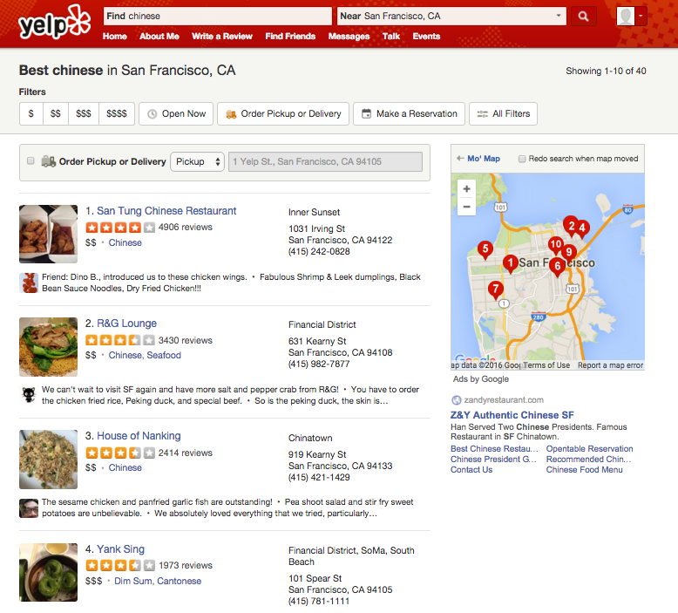
How do I know what is authentic Chinese Food? (or whatever cuisine you like) Yelp is no help.
Thousands of reviews but Yelp only filters the “good reviews”
Notes:
To motivate my project, I start out with an example. When I was living in the Midwest, I had difficulty finding genuine Chinese food (maybe not in so much a problem here in San Francisco).
I think it is an interesting problem many people have, authenticity of a restaurant. I will be using Chinese cuisine as an example in this presentation.

Slide 3
But … How do you predict Authenticity?
Fidelity to cuisines traditions – fewer menu options, more specialties, local ingredients
Features about the restaurant owner, number years in business, clientele, décor, etc.
Authenticity varies greatly even within a single country
Especially in today’s global economy, ingredients are shipped trans-continent and fusions are fad
People are idiosyncratic, especially something like taste
BOTTOM LINE: NOT EASY AND SUBJECTIVE
Notes:
I would like to predict restaurant Authenticity…because it would already be done if it was that easy.
So many ways to define it, one way is cuisine fidelity to cuisine traditions
No shortage of features but not no label to validate results
Maybe I could do a survey of the clientele?
Tend to eat only one type of cuisine
Immigrants rather cook themselves if they could do it better
Yelp is biased towards yuppies
San Francisco is harder to detect signal vs. rural areas
how many versions of menus they have (languages)
Non-authentic restaurant names – panda, golden, china, dragon, bamboo, fortune, happy, wok, express, golden, palace, take-out, fortune cookies, zodiac place mats
Menu items and names
Harder to tell when restaurants are cuisine fusion
I used big data

Slide 4
Social Network of Users & Businesses
Within community
Between Community
U2
U4
U1
Chinese1
Italian
B1
B2
U3
U5
Less Authentic
More Authentic
U6
U4
Hypothesis
- Trust reviewers from B2 if I was interested in authentic Italian food
Not trust reviewers from B1 if I was interested in authentic Chinese food
Every User has a different qualification to review a particular cuisine
Notes:
An alternative solution I took
Find Communities based on REVIEWS (User → Business) = Higher density within communities vs. between communities
How dense are within-community connections?
Do cuisine clustering inside communities?
Hypothesis:
Left Community - Disloyal reviewers who often rate other restaurants unlike B1 ( I would put less significance on these review ratings if they tend to review cuisines different from B1’s cuisine type)
Right Community - Loyal reviewers that only rate businesses just like B2 (I would trust these reviewers more (upweight ratings) because they also tend to rate cuisines like B2)
Use Community Detection Algorithms to find initial communities (Within community connections)
But then Foodies from one community may also like to eat at other restaurants outside community. (Between Community connections)
A restaurant who has a lot of users rating outside of its community is one which is more diverse (or less cohesive)
Then a restaurant who has a high proportion of business inside of its community is more similar
If so, are majority of the cuisines within community Chinese?
Based on a restaurant’s foodies, does restaurant X know what good Y food is?
How similar/ or diverse are Restaurant X’s foodies?

Slide 5


Data Pipeline
Data Collection
Scrape Yelp User & Review Data
Query Yelp API for Business Data
Data Pre-processing
Data Cleaning for Database Insertion
Data Modeling
Build Network Model – Community Detection, Centrality Measures
Compare Model Results to average Yelp Reviews
Deploy Code on Amazon Web Services
Model Evaluation
Evaluate Custom Evaluation Metrics
Visualize Business Case
Build Web-App

Slide 6
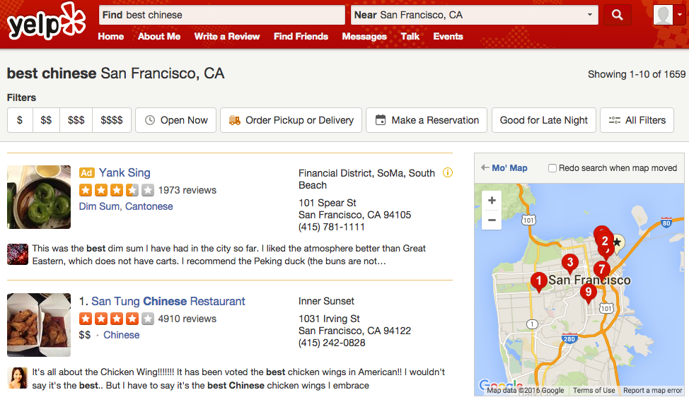
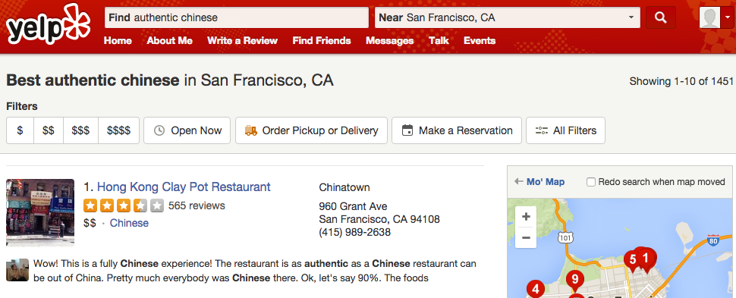
An Example - Authenticity

Slide 7
Average % Within-Community Business Reviews (All Businesses) | San Tung Restaurant
38% | 14%
User (reviewer)
OTHER Cuisine Type
Business (Restaurant)
Average % Within-Community CHINESE Business Reviews (All Businesses) | San Tung Restaurant
55% | 39%
Chinese Authenticity Score | 64% (vs. Average 30%)
CHINESE Cuisine Type
Business (Restaurant)
OTHER Cuisine Type
User -> Business
CHINESE Cuisine Type
User -> Business
Businesses: ~1,000 nodes
Users: ~17,000 nodes
Reviews: ~108,000 edges
14% businesses reviewed users are within community
Notes:
Red Vertex and Edge= connection between Chinese Cuisine restaurant and any reviewer
Blue = connections between Other Cuisine restaurant and any reviewer
14% businesses reviewed users are within community (What is the average?

Slide 8
Average % Within-Community Business Reviews (All Businesses) | Hong-Kong Clay Pot Restaurant
38% | 10%
User (reviewer)
OTHER Cuisine Type
Business (Restaurant)
Average % Within-Community CHINESE Business Reviews (All Businesses) | Hong Kong Clay Pot Restaurant
55% | 22%
Chinese Authenticity Score | 55% (vs. Average 30%)
CHINESE Cuisine Type
Business (Restaurant)
OTHER Cuisine Type
User -> Business
CHINESE Cuisine Type
User -> Business
Businesses: ~1,000 nodes
Users: ~17,000 nodes
Reviews: ~108,000 edges
14% businesses reviewed users are within community
Notes:
Red Vertex and Edge= connection between Chinese Cuisine restaurant and any reviewer
Blue = connections between Other Cuisine restaurant and any reviewer
14% businesses reviewed users are within community (What is the average?

Slide 9
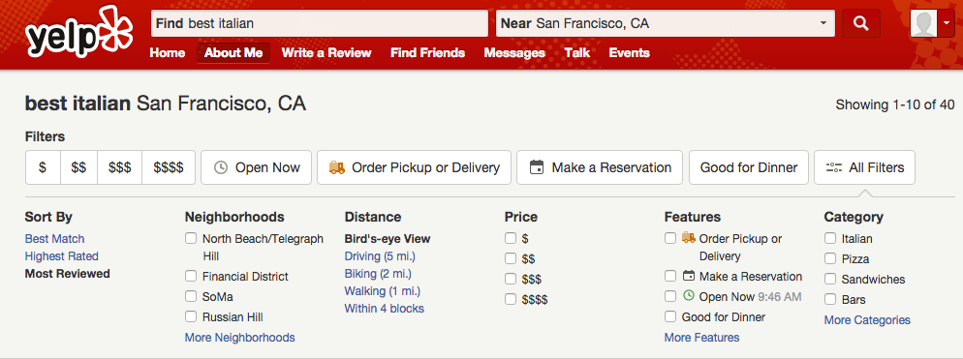
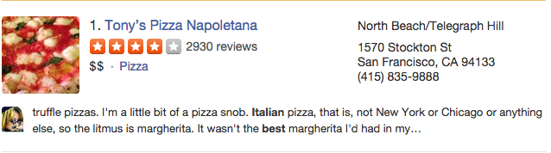
Average % Within-Community Business Reviews (All Businesses) | Hong-Kong Clay Pot Restaurant
38% | 55%
Average % Within-Community CHINESE Business Reviews (All Businesses) | Hong Kong Clay Pot Restaurant
X | 73%
Chinese Authenticity Score | 25% (vs. Average 30%)

Slide 10
Conclusions
Restaurant Authenticity is a hard problem to predict
But Social Network Graphs are versatile and can provide significant insight on which restaurants are likely more authentic
Notes:
Conclusions?

Slide 11
Foodie Network Thank you!
GitHub
LinkedIn
Alee7135@gmail.com
Notes:
App is kind of like WalkScore.com or Rateyourneighborhood. Gives you statistics about your interests, you decide what to do with it.

